Slide 1

Cross Selling Recommendation
Exploratory Data Analysis
By: Safawat Al Naser

Slide 2

Importance of Cross-Selling in banking sector!

Slide 3
Importance of Cross-selling in Banking Industry
Cross-selling allows banks to generate additional revenue streams by selling complementary products or services to existing customers
By cross-selling, banks can increase the lifetime value of each customer
Cross-selling deepens the relationship between the bank and its customers
Cross-selling encourages banks to better understand their customers' financial needs and preferences.

Slide 4
Problem Statement
Problem Statement: In this project, our client is a Latin American credit union company XYZ. They are having issues in cross-selling banking products such as credit cards, savings accounts, retirement accounts, and safe deposit boxes. It can take a significant amount of research and business knowledge to increase cross-selling. In order to succeed in the cross-selling area of the business, Data Analyst at ABC analytics is searching for the best technique to be recommended.

Slide 5
Business Understandings
Business statement: The goal of ABC analytics company is to perform Exploratory data analysis on the data provided by the client and gain some meaningful insights. As a Data analyst intern, my job was to perform EDA on the credit union’s dataset and create visualizations to analyze the data and to provide recommendations to the company to increase effective cross-selling of banking products.
EDA on XYZ Credit Union Data: XYZ Credit Union has 949614 customers registered in the data collection from Jan 28, 2015, to May 28, 2016, across 118 countries.

Slide 6
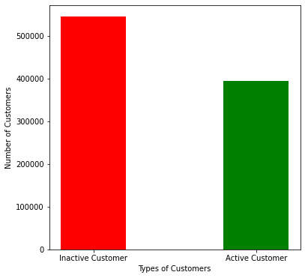
Basic Insights from EDA
There are greater number of Inactive Customers than Active Customer.

Slide 7

Correlation points?
strong correlation between Payroll and Payroll account also pansion2 and payroll account

Slide 8
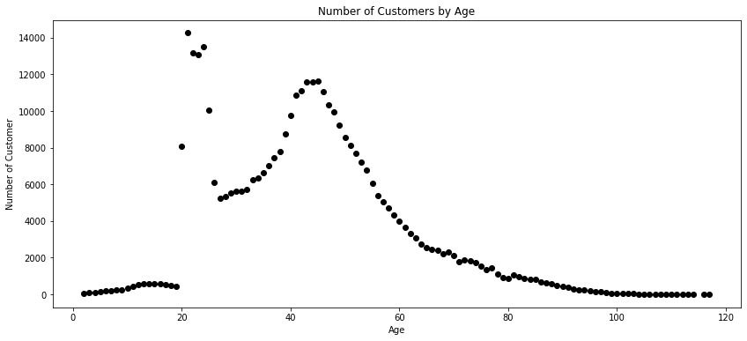
III. XYZ Credit Unions' the greatest number of customers are in the Adult Age Group.

Slide 9
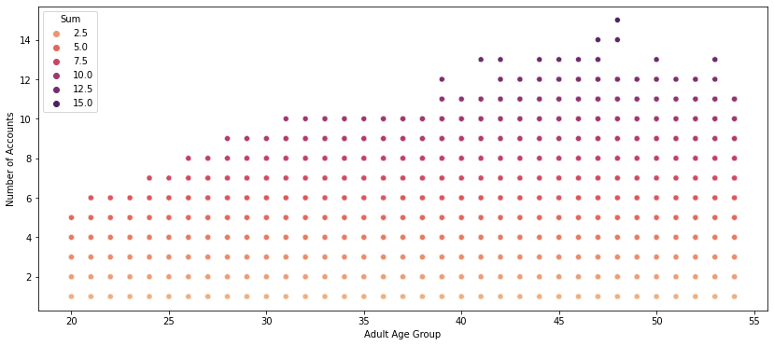
IV. Customers in the age of 40-50 are more likely to possess more than 10 different banking product at XYZ Credit Union.

Slide 10
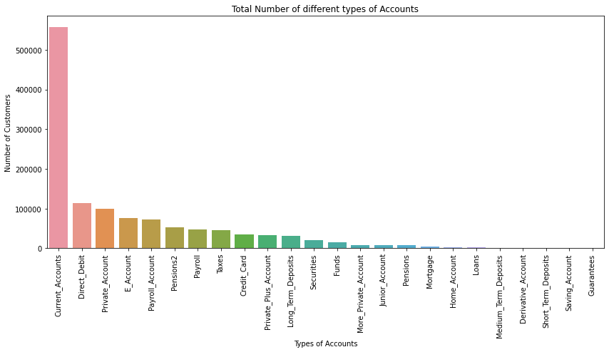
V. The highest number of accounts sold are Current Accounts, Direct Debit, and Private Account; while the lowest sold accounts are Medium Term Deposits, Short Term Deposits, Derivative accounts, Savings Account and Guarantees.

Slide 11
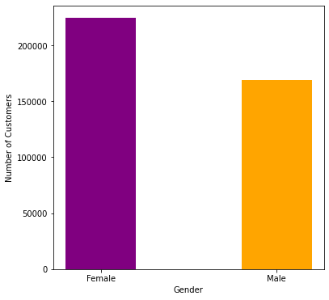
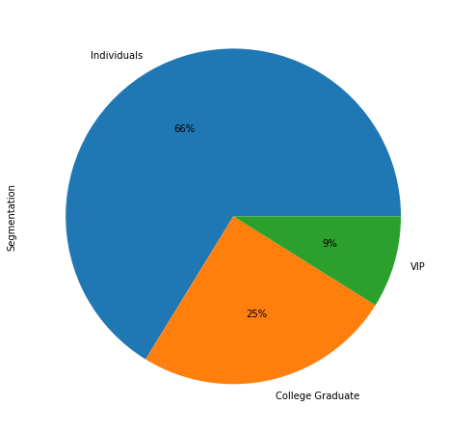
VI. There are more female customers than male customers in XYZ Credit Union.
VII. There are approximately 130,000 individuals have accounts with XYZ Credit Union. Nearly 20,000 VIP members are associated with the Union.

Slide 12
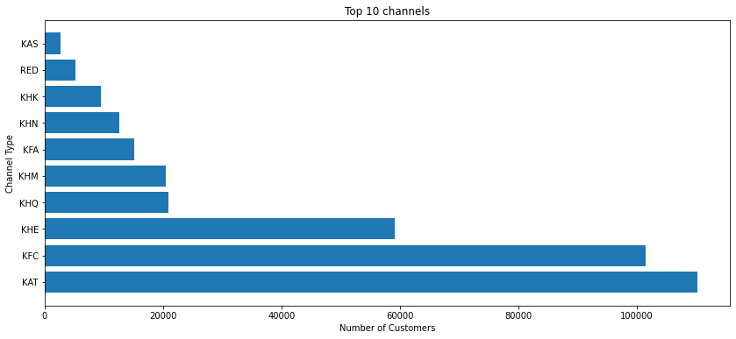
VIII. Over a million customer have joined XYZ Credit Union through top 10 channels out of total 147 channels.

Slide 13
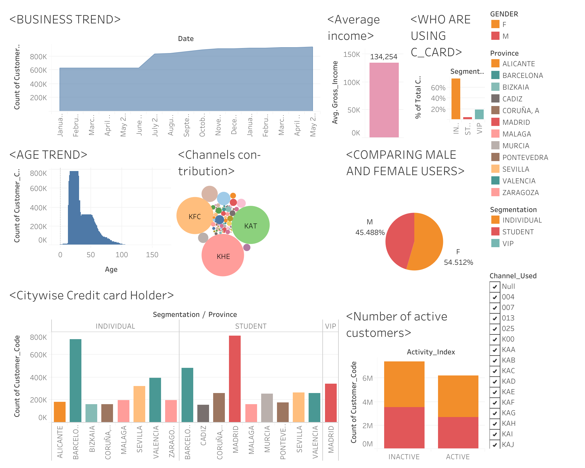
Tableau Dashboard Screenshot

Slide 14
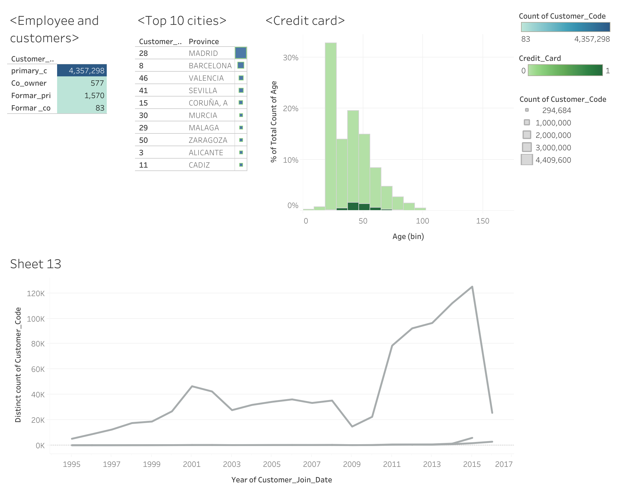
DASHBOARD SCREEN SHOT

Slide 15
Thank You

